Slide 1
Smart Pacifier - Version 2
Presented By: Aqeel, Muazzam Bin

Slide 2


Agenda
Comparison Frameworks
Further Development Plans
GRPC Integration
Plan

Slide 3
Comparison Frameworks
Avalonia (.NET)
QT
.NET MAUI
Flutter

Slide 4
Criteria | Avalonia (.NET) | Qt | .NET MAUI | Flutter
Primary Language | C# (.NET) | C++ , Python | C# | Dart
UI Paradigm | XAML-based | QT Widgets (native) or QML (declarative) | XAML-based | Widget-based
Supported Platforms | Windows macOS Linux Community efforts for mobile/web | Windows macOS Linux Android IOS | Windows macOS Android IOS (with some support for Tizen) | Android, IOS, Web, Windows, macOS, Linux Desktop is still considered somewhat less mature than mobile
Performance | Generally good for desktop apps; can leverage .NET performance optimizations | Very high performance (C++); widely used in performance-critical applications. | Near-native performance on mobile and desktop; uses platform-specific APIs under the hood. | High performance on mobile; desktop performance is improving; uses Skia for rendering.

Slide 5
Criteria | Avalonia (.NET) | Qt | .NET MAUI | Flutter
Libraries/Development Time | Growing but smaller than mainstream frameworks. Strong .NET libraries can be reused if integrated properly. Existing C# /WPF conversion | Very mature; extensive set of modules and tools for UI, networking, graphics, etc. Longer Development Efforts compared to flutter | Large .NET ecosystem; official Microsoft support, strong community, and plenty of third-party libraries. Existing C# /WPF conversion | Large and active community; Extensive set of packages (pub.dev) Wide range of UI components. Lower Development Efforts
Real-Time / Sensor Data | Possible through .NET libraries native Interop. Not as many ready-made sensor integrations for mobile applications | Excellent for embedded systems; Used in real-time or near-real-time needs. | Good support via Xamarin/MAUI bindings for Android/iOS sensors; Easy integration with .NET libraries for real-time data. | Can integrate native sensor APIs via platform channels. Real-time performance is decent but depends on plugin availability.
Licensing | Open-Source | GPL for open-source usage, Commercial licenses available for closed-source. Limited Packages, as QT has a lot of versions | Open-Source No additional licensing needed | Open-source (BSD-style license).

Slide 6
Avalonia (.NET)
Pros
NET Integration: Easily leverage existing .NET libraries and C# knowledge.
WPF-Like Approach: Familiar XAML-based structure for Windows Presentation Foundation (WPF) developers.
Desktop Focus: Good for cross-platform desktop applications (Windows, macOS, Linux).
Open Source: Licensed under the MIT License, with an active and growing community.
Cons
Smaller Community: Fewer third-party components and resources compared to more established frameworks.
Limited Mobile Support: Primarily desktop-oriented, with only community or experimental efforts for mobile/web.
Still Maturing: Not as feature-rich as some other .NET-based UI solutions (e.g., .NET MAUI).

Slide 7
Flutter
Pros
Fast Development: Hot reload, a rich widget library, and a reactive UI model for quick iteration.
Cross-Platform Reach: Builds apps for Android, iOS, Web, Windows, macOS, and Linux (desktop support is maturing).
Performance: Uses the Skia rendering engine, generally offering smooth, high-performance UIs.
Large Community & Ecosystem: Plenty of third-party packages (pub.dev) and robust documentation.
Cons
Dart Language: Less commonly used outside Flutter, so there may be a learning curve for some teams.
Desktop Support Is Newer: While improving rapidly, mobile remains Flutter’s strongest platform.
Platform Channels for Native Features: Requires bridging to native code for some hardware APIs or sensor data, which adds complexity.

Slide 8
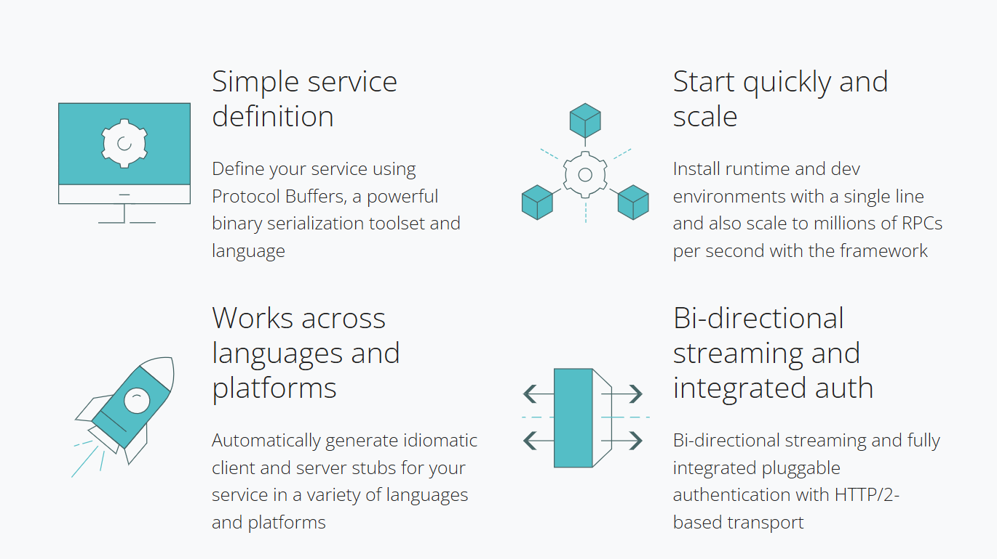
What is gRPC
gRPC is a modern open-source high performance Remote Procedure Call (RPC) framework
Is able to be executed on any environment
It can efficiently connect services in and across data centers with pluggable support for
load balancing,
tracing,
health checking
authentication
It is also applicable in last mile of distributed computing to connect devices such as; mobile applications and browsers to backend services.
gRPC's use of protobuf for binary serialization

Slide 9
When to Include gRPC?
Better performance (faster than REST)
You already use Protobuf in your .NET backend
You need streaming (real-time updates using gRPC Streams)
Your devices support HTTP/2 (Flutter, .NET, and modern browsers do)
When not to use?
You need to support browsers (REST API or GraphQL is better)
Your network doesn’t support HTTP/2 (some proxies/firewalls block gRPC)
You want a human-readable format (use REST API with JSON)

Slide 10
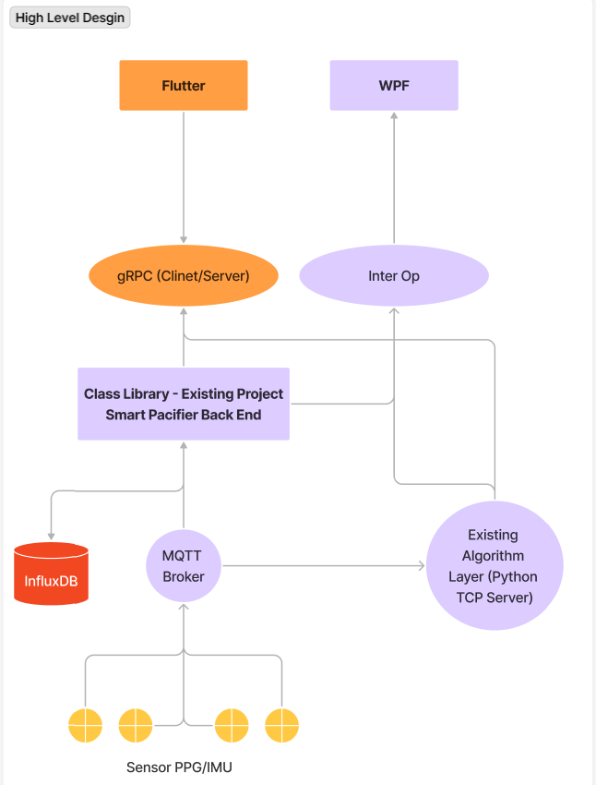
Plan → Development
Flutter + Existing Backend Code (Class Library .NET Framework)
Steps:
Running .NET gRPC Server Locally for Flutter
Development Steps
1: Configure .NET to Listen on Local Network
2: Start the .NET Backend Locally
Running Flutter App Locally (gRPC Client)
Development Steps
1: Develop the UI
2: Connect the gRPC Client → gRPC Server

